Slide 1


SAP UI5 & FIORI with OData TRAINING using BAS
Anubhav Oberoy
Day – 14

Slide 2

Agenda – Day 14
Understanding the CORS Policy Issue
Integrating the OData in Fiori App
Binding our app with Odata properties
Supporting the Pagination
Getting the Associated Data
Making the POST call using the UI
Making Update call from UIMaking Delete call from UI
Calling the Function Import in the UI
Delivering our Fiori App
Adding deployment Configuration to our app
Deploying our app to the SAP ABAP Repository

Slide 3
CORS – Cross Origin Resource Sharing
It is a browser security policy which prevent us connecting to a domain while running web page on a different domain.
Browser
S
https://localhost:8080
Proxy
Facebook.com
Google.com
Another Server
http://103.207.171.202:8021/sap/opu/odata/sap/ZOCT_ODATA_SRV/$metadata
https://www.npmjs.com/package/@sap/ux-ui5-tooling

Slide 4
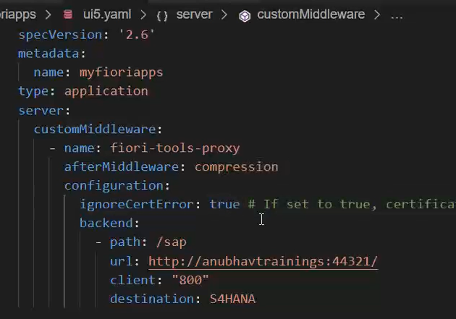
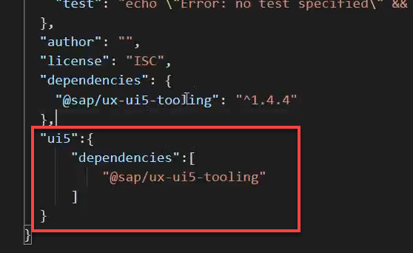
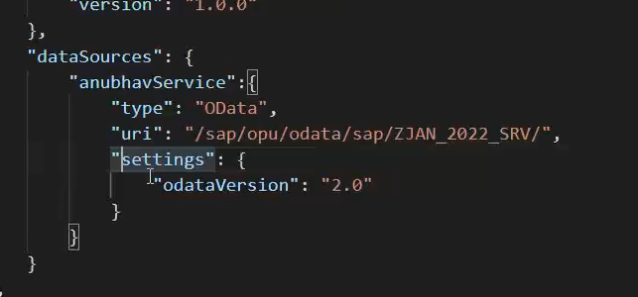
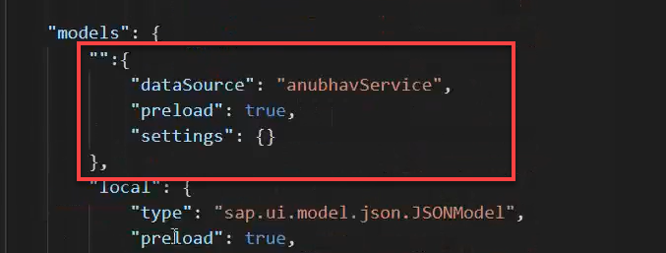
Integrating OData in Fiori App
Before we start OData integration in our fiori project we need have to check that, we have added the package.json and ui5.yaml file in our project, if the we haven’t add then run these commands in the terminal to added these files:
npm init
ui5 init
Now we have the required file in the project, we can proceed the integration.
Go to ui5.yaml file and add the middleware code (given in the link) to the file and save it.
Add the dependency of sap/ux-ui5-tooling to the project using the command: npm install @sap/ux-ui5-tooling
Now add the ui5 section in the package.json file to specify the dependencies related to ui5.
Now go to the manifest.json file we have to add a dataSource under the sap.app section and then create a default model to consume the service in UI.

Slide 5
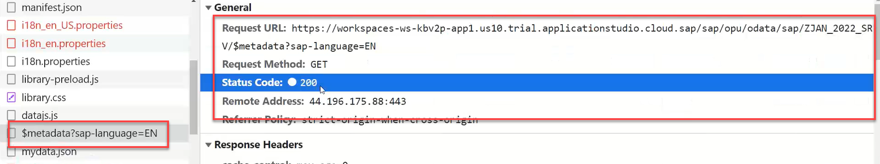
Hands – on: Consume OData service
Follow the steps given in the previous slide to configure the fiori app in BAS to consume the Odata service.
Once the configuration is complete the app will call the metadata of the application which we can check in the Network tab in browser.
Code Link:-
ui5.yaml
package.json
manifest.json

Slide 6
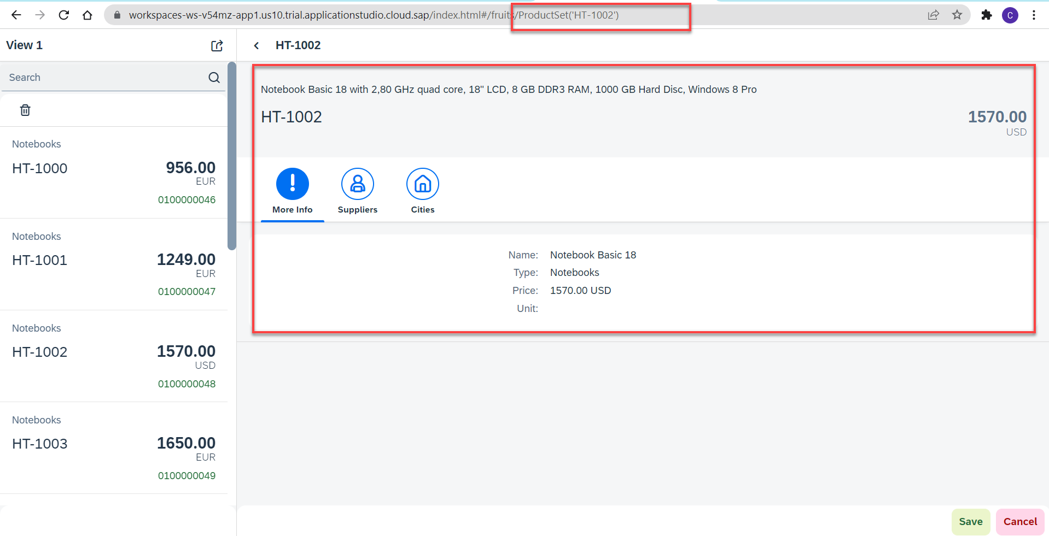
Hands – on: Binding the app with odata
Now to get the data into the application we have to change the binding of the application. Initially the app is bind to the fruits data, so we have to bind it form the OData properties.
We also have to change the Route Match Handler (herculis) code in the View2 controller.
We have to add the growing property to the list to support pagination.
And we also have to change the search function to support the filter on the CATEGORY.
Code Link:-
View1.view.xml
View1.controller.js
View2.view.xml
View2.controller.js
moreInfo.fragment.xml

Slide 7
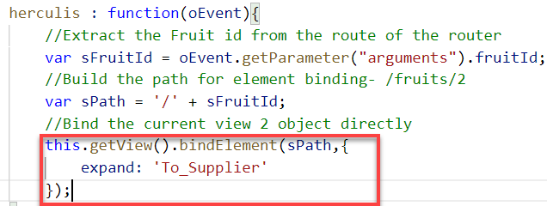
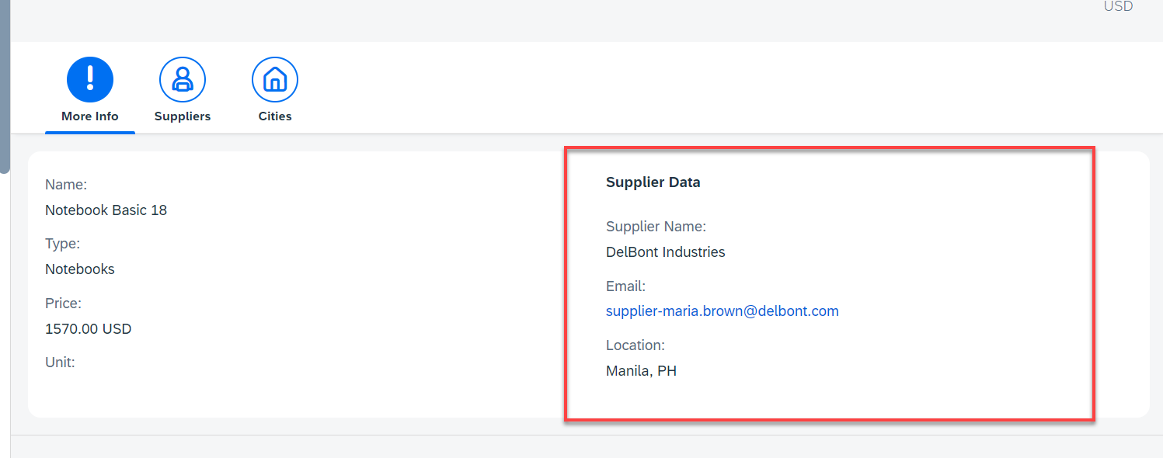
Hands – on: Getting the Associated Data
Now we want load the associated data on the UI. To do that we will create a new form in the moreInfo Fragment and in that form we will load the Supplier data of the product.
We will also have to make some changes in the Binding of the View2 to load the dependent data.
Code Link:-
View2.controller.js
moreInfo.fragment.xml

Slide 8
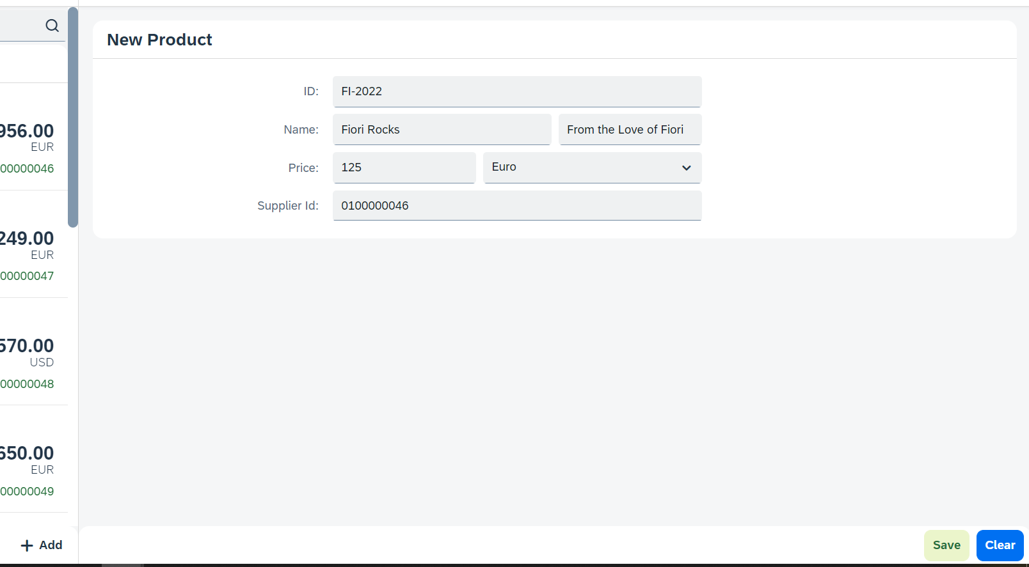
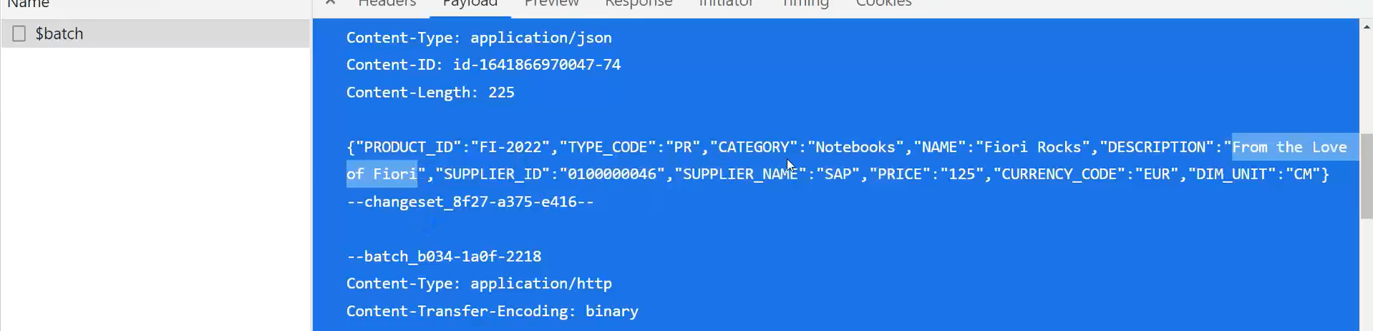
Hands – on: Making POST call from UI
Now we will add a new view named as Add. In this view will add a simple form to enter the product details and then on press of the Save a new Product will be created in the backend.
We will also add a Clear button to clear the form.
Code Link:
View1.view.xml
View1.controller.js
Add.view.xml
Add.controller.js
manifest.json

Slide 9
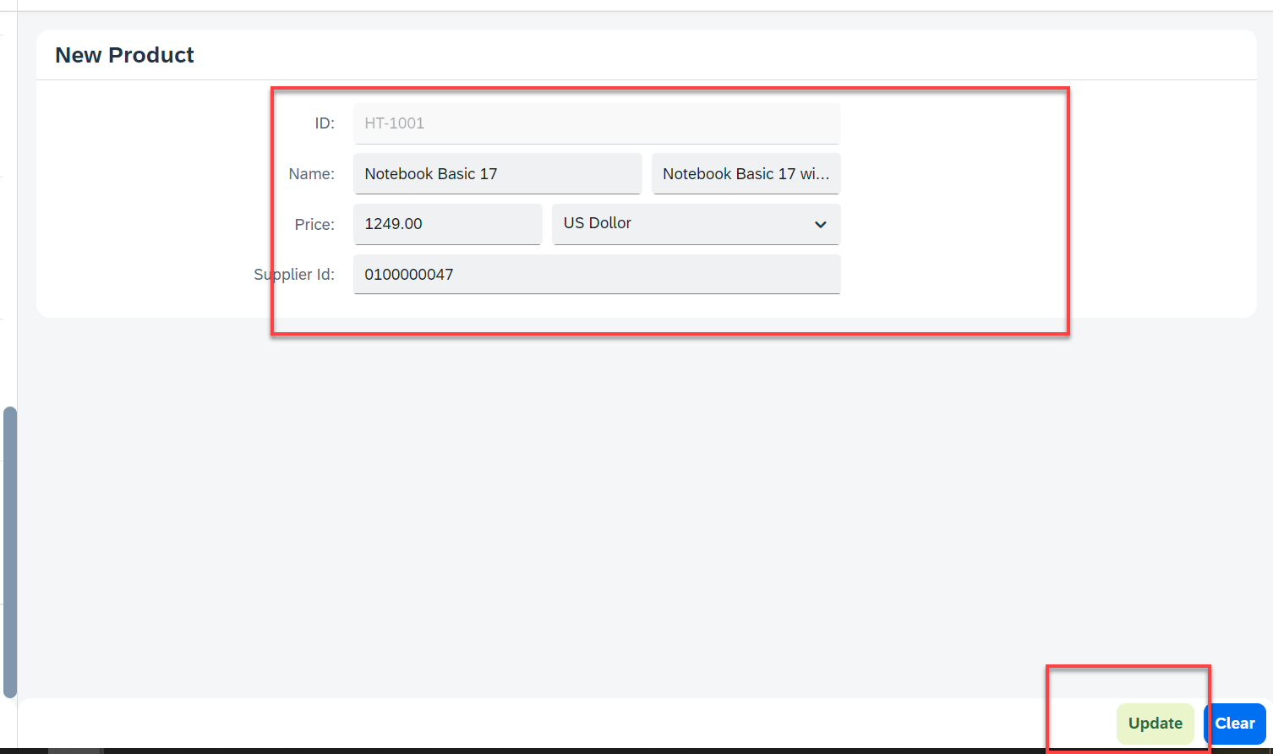
Hands – on: Making Update call form UI
Now will add a functionality to update a Record form the backed. But before that we will have to load the record in the form and then we will update that recode and save it.
Code Links:-
Add.view.xml
Add.controller.js

Slide 10
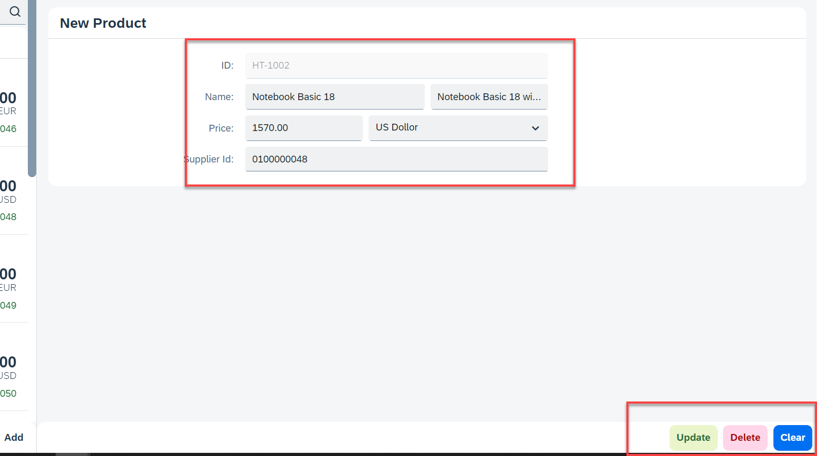
Hands – on: Making Delete call from UI
Now we want to delete a selected record form the UI. To do that we have to make a delete button in the UI and on press of that delete button the record will be deleted form the backend.
Code Links:-
Add.view.xml
Add.controller.js

Slide 11
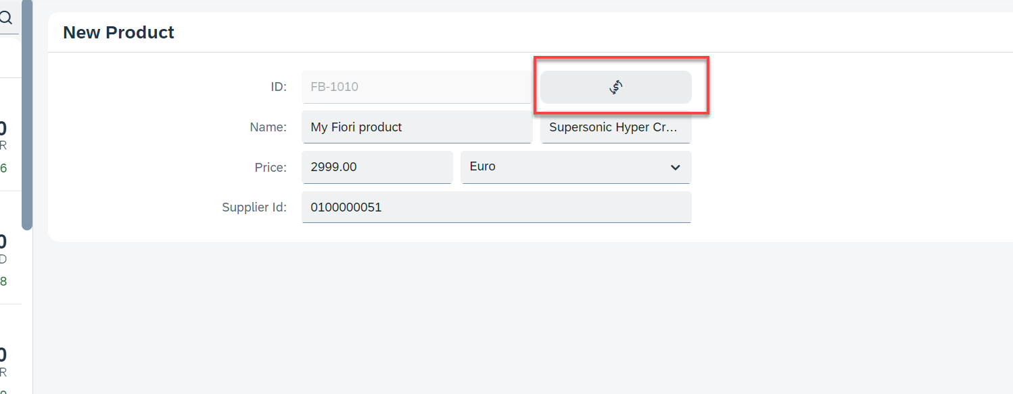
Hands – on: Calling the Function Import
Now load the most expensive data on the Add View. To do that we will add a button next to the Product ID field and on press of that button we will make a call to the Most Expensive Products function which we have created. And then load the data into the form.
Code Link:-
Add.view.xml
Add.controller.js

Slide 12
Delivering Fiori Apps
Currently the Application we have developed is in our local system (VS Code or BAS). Now we want this app to be accessible by other people in our company, to do that we have to deploy this application to our ABAP environment or cloud platform where it can be accessed by others.
BAS/VS Code
GitHub
Development Team
destination
SCC
DEV
QLT
PROD
BSP App
BSP App
BSP App

Slide 13







Delivering Fiori Apps
2
ui5 build
Development Environment
(BAS, VSCode, etc.)
1
git push
dist
GitHub Repository
3
npm run deploy-config
Developer
deployment configuration
End Users
4
npm run deploy
ABAP Repository
PROD (P)
DEV
Quality(Q)
Transport Request
Transport Request
Admin
Launchpad and Launchpad Designer

Slide 14
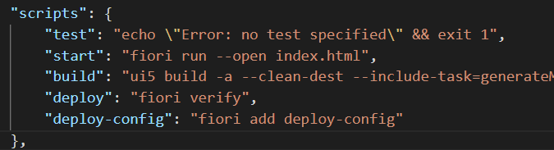
Adding deployment Configuration to App
Steps to configure the Application to deploy the Application on ABAP Environment.
Open the terminal in BAS or VS Code and go to your project folder.
Open terminal in you project folder.
Write command ui5 build or npm run build and press enter to build your project it will create a dist folder.
Now write command npx fiori add deploy-config to configure the project for deployment.
Select a target ABAP system … http://103.207.171.202 in your case your hostname will come in this step.
Enter the ABAP system client number …
Enter a username …
Enter a password …
Enter an application name …
Enter a description for the application …
Enter a package for the deployed application … $TMP
Now to deploy the application to the ABAP repository we use the command npm run deploy.

Slide 15
Title
Content

Slide 16

End of Day 14

Slide 17

Questions

Slide 18

Anubhav Oberoy

Slide 19


We’re committed to empower you to be
Most Desirable Resource
through powerful training solutions.
We build the workforce of the future.
250+
Corporate Clients
30,000+
Learners Trained
25000+
Learners Placed
FREE WEBINARS
Sign up for free webinars with industry experts every fortnight!
Enroll Now!
Contact us today!
https://anubhavtrainings.com/

Slide 20




More from AnubhavTrainings.com

Slide 21
Title
Content

